Slide 1
SWE3002
Information System and Security
Module : Public Key Crypto System
Prof. Jayasudha M
VIT Chennai

Slide 2

Euclidean algorithm
Since gcd(a,b) = gcd(b,a) = gcd(|a|,|b|),
w.l.g., assume: a ≥b>0
say:
d=gcd(a,b)
a=q₁*b+r₁ where 0≤r₁<b
case:
If r₁=0 then b|a →gcd(a,b)=b
If r₁≠0 then
since, d|b ∧ d|a, ∴ d|(a-q₁*b), i.e. d|r₁
therefore, d=gcd(b,r₁)
function gcd(a, b)
if b = 0
return a;
else
return gcd(b, a mod b);
The accompanying pseudocode is written slightly differently
Prof M Jayasudha,VIT Chennai,India

Slide 3
Euclidean algorithm Cont.,
we have:
d=gcd(a,b)=gcd(b,r₁)
now consider gcd(b,r₁):
using same line of reasoning
gcd(b,r₁)=gcd(r₁,r₂)
where b= q₂*r₁+r₂
so we have: d=gcd(a,b)=gcd(b,r₁) =gcd(r₁,r₂)
d=gcd(a,b)=r_{n}
function gcd(a, b)
if b = 0
return a;
else
return gcd(b, a mod b);
a=q₁b + r₁ 0<r₁<b
b=q₂r₁+ r₂ 0<r₂<r₁
r₁=q₃r₂+r₃ 0<r₃<r₂
Prof M Jayasudha,VIT Chennai,India

Slide 4
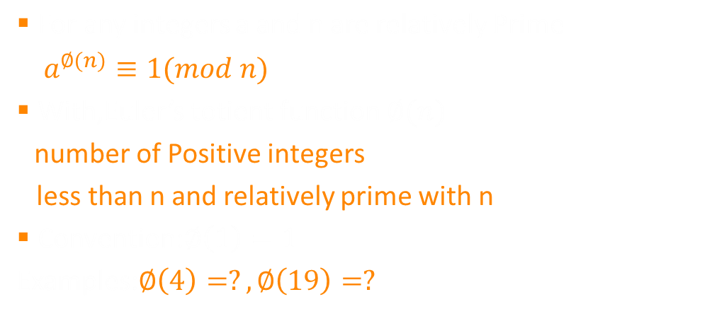
Euler’s totient Theorem
Ans: 2, 4
Prof M Jayasudha,VIT Chennai,India

Slide 5
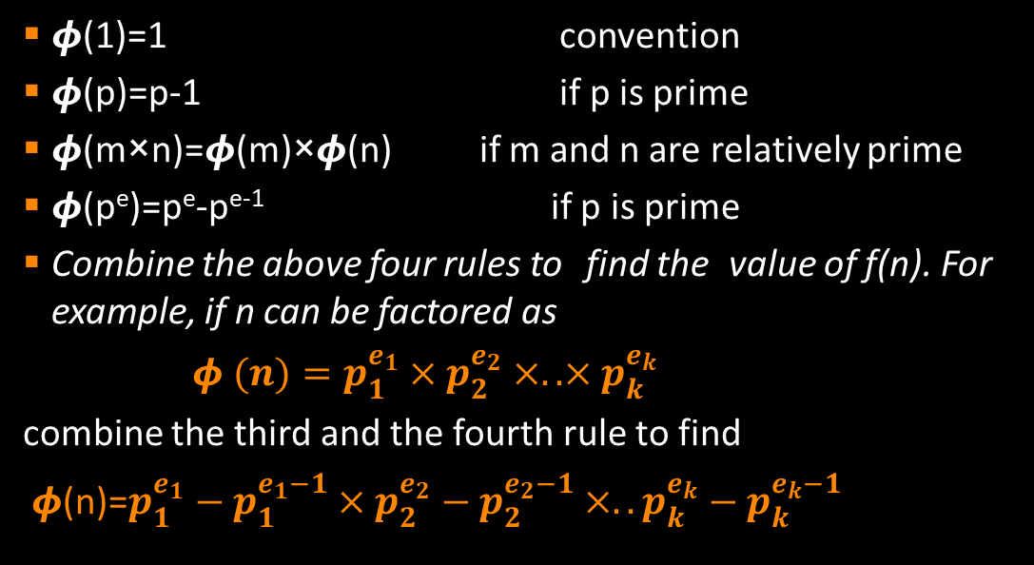
Euler’s totient function
Prof M Jayasudha,VIT Chennai,India

Slide 6
RSA Algorithm
The most common public key algorithm- named for its inventors Rivest, Shamir, and Adleman (RSA) – year 1977
Block cipher scheme
Plaintext and ciphertext are numbers – between 0 and n-1 for some n
Typical size of n is 1024 bits (309 decimal digits)
Make use of an expression with exponentials
Having key generation algorithms, encryption and decryption algorithms
Prof M Jayasudha,VIT Chennai,India

Slide 7
Mathematics behind RSA
Theorem 1 : Let a, p be two integers that are co-prime to each other. Then, there is only a unique integer x ∈ Zp satisfying
ax mod p = b (Regardless of the value of b.)
Corollary(1) : If a and p are co-prime to each other, then 0, a, 2a, ..., (p - 1)a are all distinct after modulo p.
Theorem 2(Fermat’s Little Theorem) : If p is a prime number, for any non-zero a ∈ Zp, it holds that
a ⁽ ^{p-1)} mod p =1
Theorem 3(Chinese Remainder Theorem) : Let p and q be two co-prime integers. Then
If x mod p = 1 and x mod q = a then x mod pq = a
Prof M Jayasudha,VIT Chennai,India

Slide 8
Mathematics behind RSA
Eulers Totient Function(ø) : When doing arithmetic modulo n then
The complete set of residues is: 0...(n-1)
The reduced set of residues is those numbers (residues) which are relatively prime to n
Number of elements in reduced set of residues is called the Euler Totient Function ø(n)
If the the number ‘n’ is a prime number then the value of
ø(n)=n-1
Prof M Jayasudha,VIT Chennai,India

Slide 9
RSA Algorithm
Key Generation
p,q two prime numbers (private, chosen)
Compute n = pq; φ(n)=(p-1)(q-1) (public, calculated)
Select e, with gcd( φ(n), e) = 1; 1 < e < φ(n) (public , chosen)
Find d = e⁻¹ (mod φ(n)) (private, calculated)
Now, private key {d,n} public key {e,n}
Prof M Jayasudha,VIT Chennai,India

Slide 10

RSA Algorithm
Encryption
User A
private key {d_{A}, n}
public key {e_{A},n}
Assume User A wants to send a message M < n
User B
private key {d_{B}, n}
public key {e_{B},n}
e_{B}
User B’s public key
_{Compute C=} _{M} e_{B mod n}
Ciphertext ‘C’
Prof M Jayasudha,VIT Chennai,India

Slide 11
RSA Algorithm
Decryption
User A
private key {d_{A}, n}
public key {e_{A},n}
User B
private key {d_{B}, n}
public key {e_{B},n}
Ciphertext ‘C’
_{Compute M=} _{C} d_{B mod n}
Original Message sent by User A
Prof M Jayasudha,VIT Chennai,India

Slide 12
RSA Algorithm
Example :Alice wants to send a message M=88 to Bob
Key Generation Process for Bob
p=17, q=11 two prime numbers
Compute n=pq =17*11=187; φ(n)=(p-1)(q-1)=16*10=160
e=7, with gcd( 160, 7) = 1; 1 < 7 < 160
d = 7⁻¹ (mod 160) i.e. e*d= 1 mod 160 7*23 = 1 mod 160 [Apply extended Euclid’s Algorithm]
Now, Bob’s private key {23,187} public key {7,187}
Prof M Jayasudha,VIT Chennai,India

Slide 13
RSA Algorithm
Encryption
Alice
private key {d_{A}, n}
public key
{e_{A}, n}
Alice wants to send a message 88 < 187
Bob
private key {23,187}
public key {7,187}
7
Bob’s public key
_{Compute C=} ₈₈ 7 _{mod 187}
Ciphertext ’11’
Prof M Jayasudha,VIT Chennai,India

Slide 14
RSA Algorithm
Decryption
Alice
private key {d_{A}, n}
public key {e_{A},n}
Bob
private key {23, 187}
public key {7,187}
Ciphertext ‘11’
_{Compute M=} ₁₁ 23 _{mod 187}
Original Message M=88 sent by Alice
Prof M Jayasudha,VIT Chennai,India

Slide 15
Applications
To protect web traffic, in the SSL protocol (Security Socket Layer),
To guarantee email privacy and authenticity in PGP (Pretty Good Privacy)
To guarantee remote connection in SSH (Secure Shell).
Furthermore it plays an important role in the modern payment systems through SET protocol (Secure Electronic Transaction).
RSA has been used in most digital data, information and telephone security applications.
Prof M Jayasudha,VIT Chennai,India

